Slide 1
IE 411/511:
Visual Programming for Industrial Applications
Lecture Notes #6
Exception Handling
and
Working with Databases

Slide 2
Module Learning Objectives
In this module you will learn:
When to use exception handling
What exceptions are and how they are handled
To use Try blocks to delimit code in which
exceptions might occur
To use Catch blocks to specify exception handlers
The .NET exception class hierarchy
  Exception properties
To use the Finally block to release resources

Slide 3
Module Learning Objectives (cont.)
The relational database model
To write basic database queries in SQL
To add controls to projects that manipulate data from a database

Slide 4
Exception Handling

Slide 5
Introduction
It is very difficult to create perfect computer code from the beginning
  More often than not, programmers have to address imperfections to develop successful Visual Basic solutions
The terms error and exception are often used interchangeably
  An error is an event that happens during the execution of code that interrupts or disrupts the code's normal flow
  An exception is the object that the error event creates

Slide 6
Introduction (cont.)
Programmers use the phrase throwing an exception to mean that the method in question encountered an error
  The reaction from the method is to create an exception object that contains information about the error and when/where it occurred
Factors that cause errors and subsequent exceptions include
  User error
  Resource failures, and
  Failures of programming logic

Slide 7
Introduction (cont.)
For the purpose of this module, exception handling means interpreting and reacting to the exceptions created by error events
Exception handling enables you to
  Create Visual Basic solutions that can resolve exceptions
  Improve the fault tolerance of a Visual Basic solution

Slide 8
Exception Handling Overview
Programs frequently test conditions to determine how program execution should proceed
Example
Perform a task
If the preceding task did not execute correctly
Perform error processing
Perform next task
If the preceding task did not execute correctly
Perform error processing
…
…

Slide 9
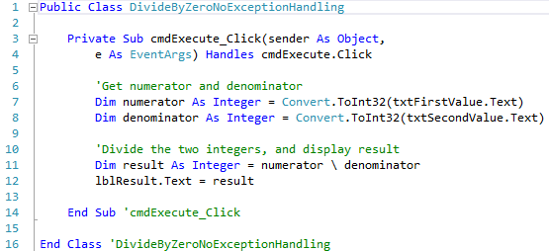
Exception Handling Overview (cont.)
An exception is thrown when a method detects a problem and is unable to handle it
Example program without exception handling
Converting input into Integer can result in a FormatException
Division can cause a DivideByZeroException

Slide 10
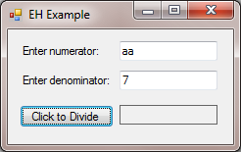
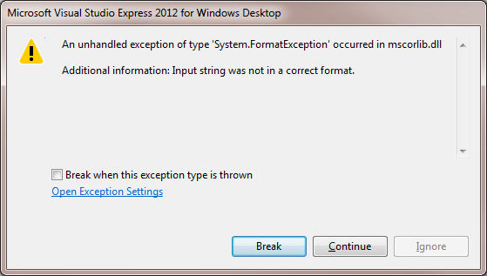
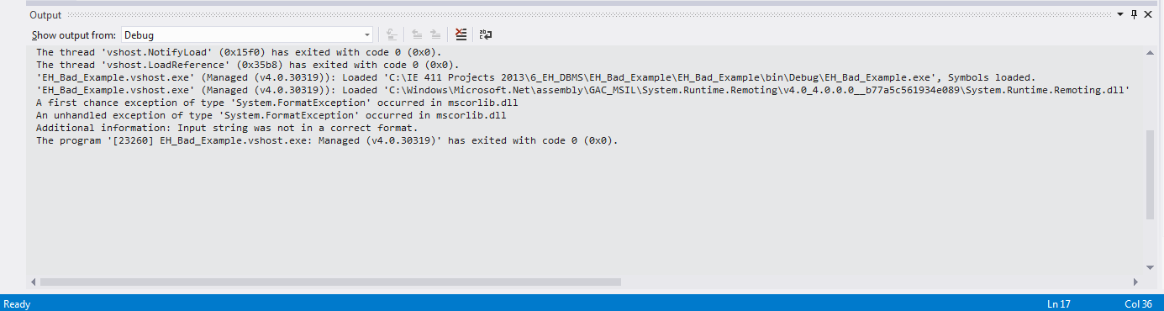
Exception Handling Overview (cont.)
Potential execution outcomes (1 of 2)

Slide 11
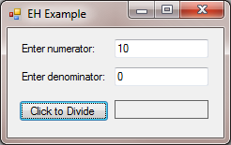
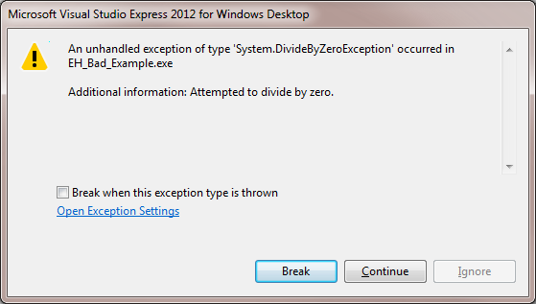
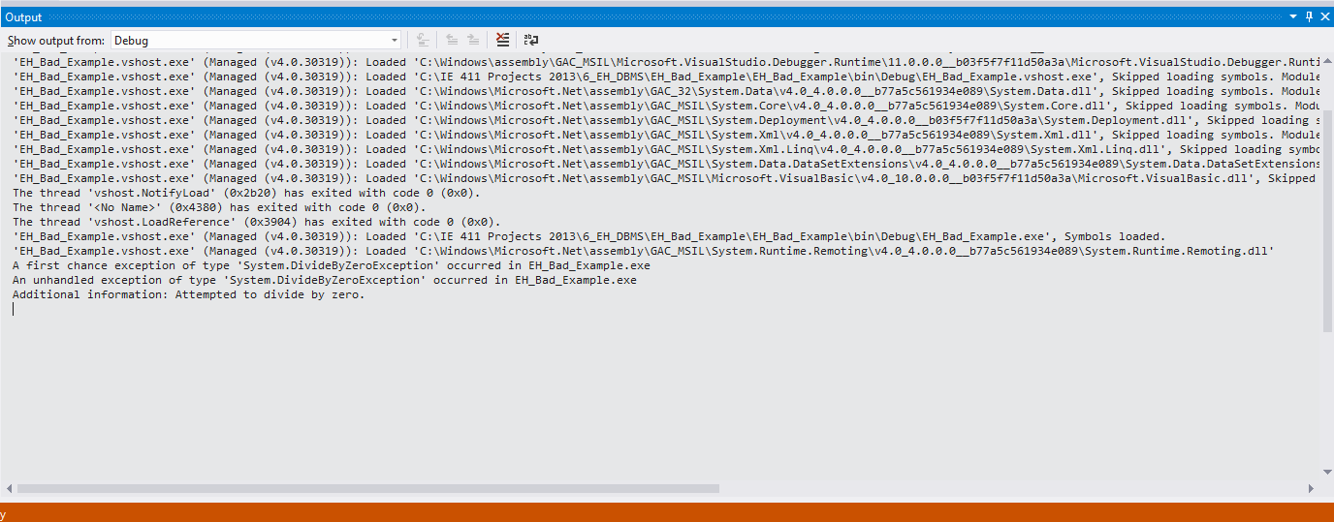
Exception Handling Overview (cont.)
Potential execution outcomes (2 of 2)

Slide 12
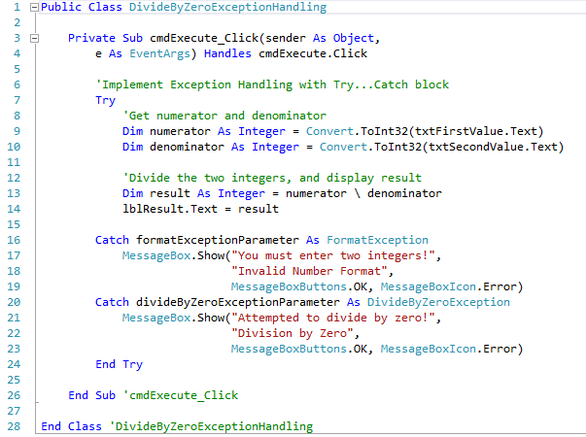
Exception Handling Overview (cont.)
Example program with exception handling

Slide 13
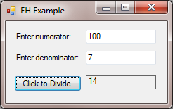
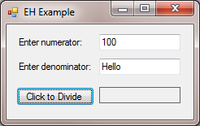
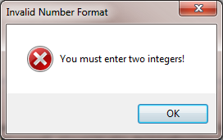
Exception Handling Overview (cont.)
Potential execution outcomes (1 of 2)
  Entering valid input
  Entering a String instead of an Integer and corresponding error notification

Slide 14
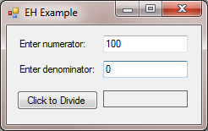
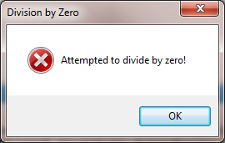
Exception Handling Overview (cont.)
Potential execution outcomes (2 of 2)
  Entering zero as the denominator and corresponding error notification

Slide 15
Catching Exceptions
When an exception occurs in a Try block, a Catch block catches the exception and handles it
The exception parameter in a Catch block represents the exception type that it can handle
  formatExceptionParameter → FormatException
  divideByZeroExceptionParameter → DivideByZeroException
The program executes only the first matching Catch block

Slide 16
Catching Exceptions (cont.)
Uncaught Exceptions
An uncaught exception is an exception for which there is no matching Catch block
An UnhandledException event is raised when an exception is not caught by the program
  Handling this event allows the application to possibly handle the exception before the program terminates
  Last-minute actions can occur, such as saving data for future recovery

Slide 17
Catching Exceptions (cont.)
Termination Model of Exception Handling
After the exception is handled, program control resumes after the last Catch block
This is known as the termination model of exception handling
The Try block and its corresponding Catch and Finally blocks together form a Try statement

Slide 18
Catching Exceptions (cont.)
Common Programming Errors
Logic errors can occur if you assume that after an exception is handled, control will return to the first statement after the throw point
  The throw point is the line of code when the error occurred
Specifying a comma-separated list of parameters in a Catch block is a syntax error
  A Catch block can have at most one parameter

Slide 19
.NET Exception Hierarchy
Class SystemException
Class Exception is the base class of the exception hierarchy
The Common Language Runtime (CLR) generates System­Exceptions, derived from Exception
  If a program attempts to access an out-of-range array index, the CLR throws an exception of type IndexOutOfRangeException
Using inheritance enables a Catch block to catch related exceptions

Slide 20
.NET Exception Hierarchy (cont.)
How to determine which exceptions a method throws?
  For methods of the .NET Framework, read the online documentation (accessible through the Help menu)
  A section called Exceptions specifies the exceptions the method throws
If a method throws exceptions, statements that invoke the method directly or indirectly should be placed in Try blocks, and those exceptions should be caught and handled

Slide 21
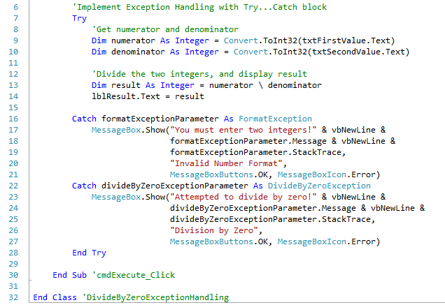
Exception Properties
Property Message stores the error message associated with an Exception object
Property StackTrace contains a String that represents the method-call stack

Slide 22
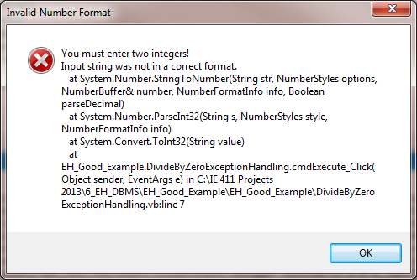
Exception Properties (cont.)
Format Exception Example

Slide 23
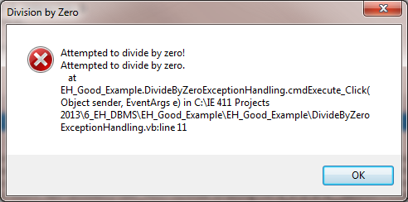
Exception Properties (cont.)
Division by Zero Exception Example

Slide 24
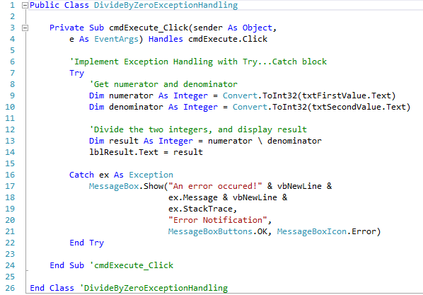
.NET Exception Hierarchy
Class SystemException
Example of the use of the class Exception

Slide 25
Finally Block
Programs frequently request and release resources
at execution time
  For example, when a program finishes processing a data file, the program should close the data file so other programs can use it
If the file is not closed, a resource leak occurs
  The CLR will not garbage collect an object until the program contains no more references to that object, and may not garbage collect for some time afterward
  Memory leaks can occur if you inadvertently keep references to unwanted objects

Slide 26
Finally Block (cont.)
If an exception occurs, the Try block may “expire” before resource-release code can execute
The optional Finally block is guaranteed to execute regardless of whether the Try block executes successfully
Local variables of a Try block cannot be accessed in the Finally block
  Also, placing the Finally block before a Catch block is a syntax error

Slide 27
Finally Block (cont.)
If the Try block successfully completes, or if a Catch block handles the exception, the program continues its execution
If an exception is not caught, or if a Catch block rethrows an exception, program control continues in the next enclosing Try block

Slide 28
Finally Block (cont.)
It is best to place one Try block around a significant portion of code, and follow this Try block with Catch blocks that handle each of the possible exceptions
Then follow the Catch blocks with a single Finally block
Separate Try blocks should be used when it is important to distinguish between multiple statements that can throw the same exception type

Slide 29
Working with
Databases

Slide 30
Introduction
A database is an organized collection of data
Relational databases are organized as tables with rows and columns
A database management system (DBMS) provides mechanisms for storing, organizing, retrieving and modifying data
Structured Query Language (SQL) is the international standard for accessing relational databases

Slide 31
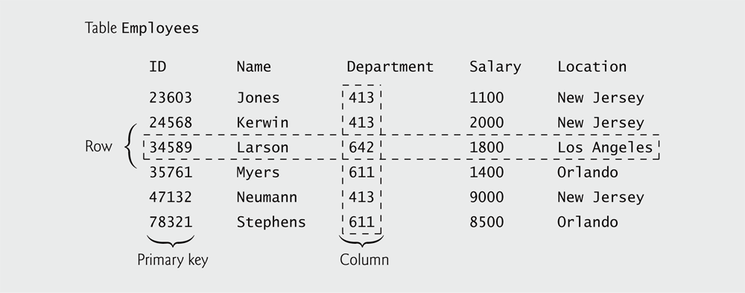
Relational Databases
A relational database is a logical representation of data that allows the data to be accessed independently of its physical structure
A relational database organizes data in tables
In the example table shown below, the ID column is the table’s primary key
  A primary key is a unique identifying value

Slide 32
Relational Database Example
A database’s tables, their fields and the relationships between them are collectively known as a database schema
The Books database consists of three tables
  Authors
  AuthorISBN, and
  Titles

Slide 33
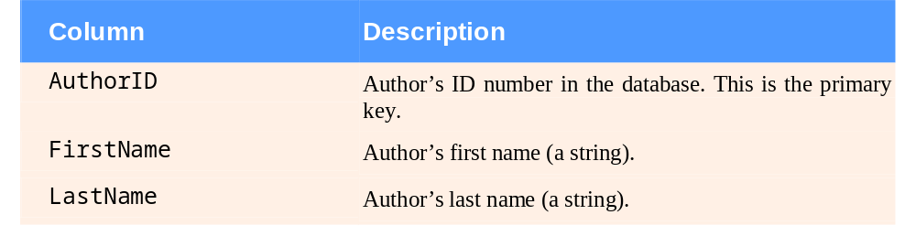
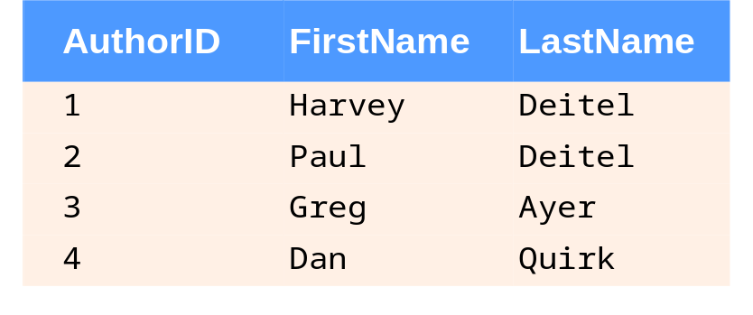
Relational Database Example (cont.)
Authors table of the Books database and sample data

Slide 34
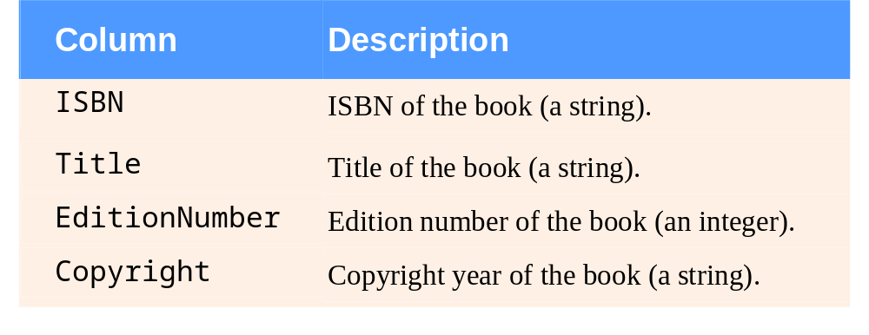
Relational Database Example (cont.)
The Titles table has four fields, each represented by a column

Slide 35
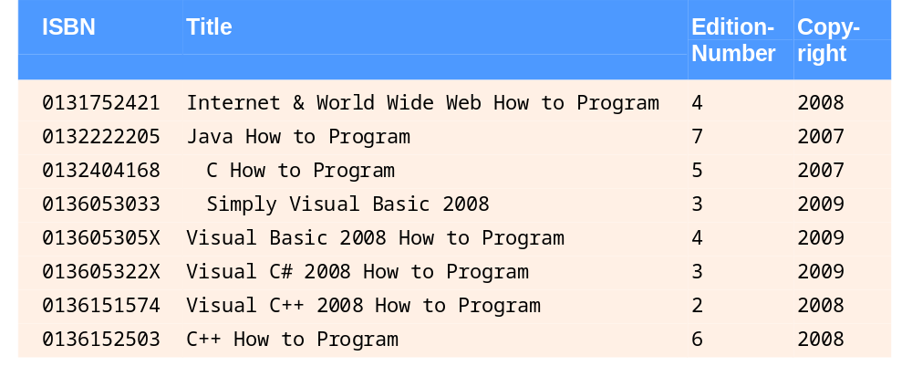
Relational Database Example (cont.)
Sample data in the Titles table

Slide 36
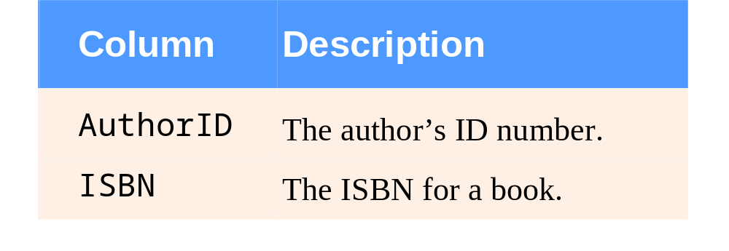
Relational Database Example (cont.)
The AuthorISBN table consists of two columns
The AuthorID and ISBN columns are foreign keys
  Columns that match the primary key of another table

Slide 37
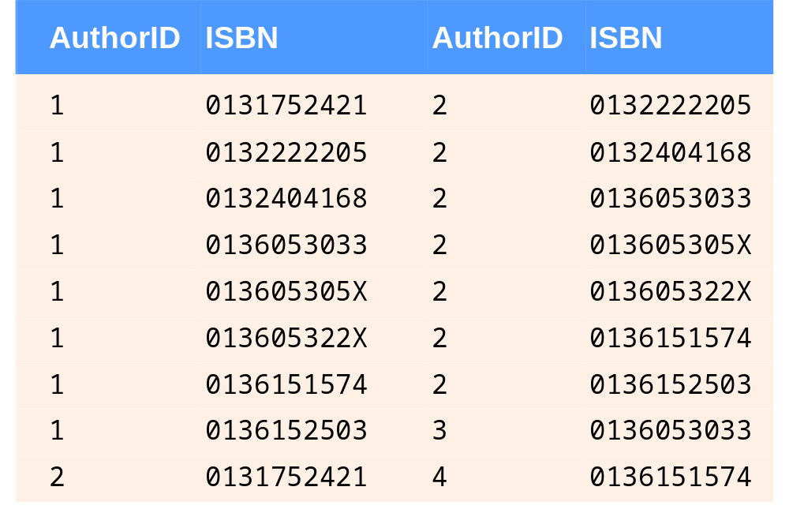
Relational Database Example (cont.)
Sample data in the AuthorISBN table

Slide 38
Relational Database Example (cont.)
A foreign key helps maintain the Rule of Referential Integrity
  Any foreign key value must be another table’s primary key
Foreign keys allow related data in multiple tables to be selected from those tables
  This is known as joining the data
There is a one-to-many relationship between a primary key and a corresponding foreign key

Slide 39
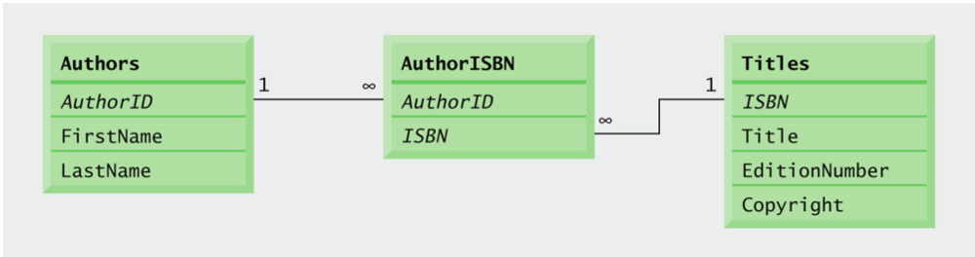
Relational Database Example (cont.)
An entity-relationship (ER) diagram for the Books database

Slide 40
Structured Query Language
Structured Query Language (SQL) is the international standard language used almost universally with relational databases to perform queries
A query is a set of instructions used to request information from a database that satisfies a given criteria
Programs use SQL to define queries to select subsets of data from a table

Slide 41
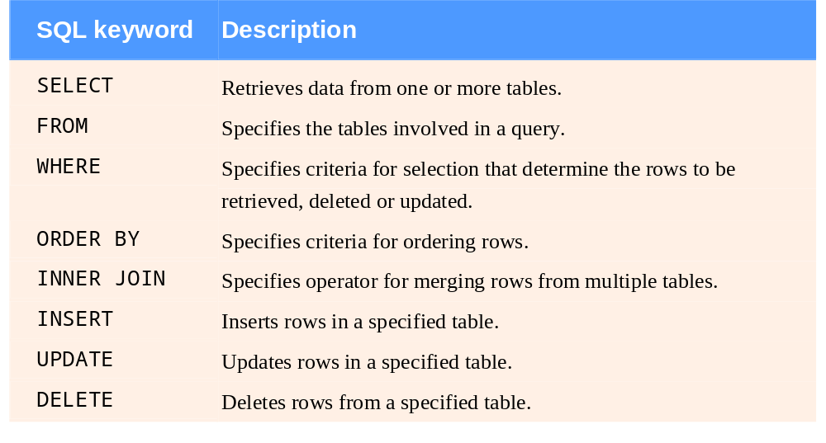
SQL (cont.)
Common SQL keywords used to form SQL statements

Slide 42
SQL (cont.)
Basic SELECT Query
A SQL query selects rows and columns from a database
SELECT * FROM tableName
The asterisk (*) represents all the columns in the table

Slide 43
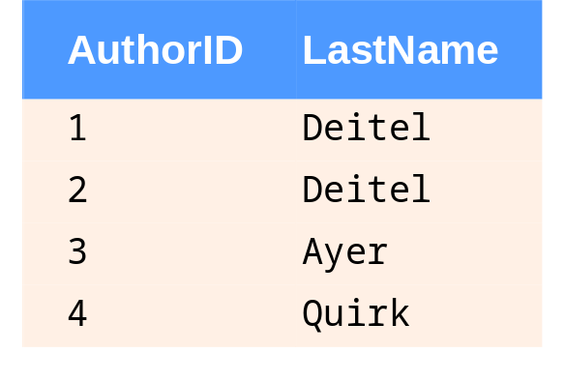
SQL (cont.)
To retrieve only specific columns, use a comma-separated list
SELECT AuthorID, LastName FROM Authors
This query returns only the following data

Slide 44
SQL (cont.)
WHERE Clause
SQL uses the optional WHERE clause to specify selection criteria
    SELECT columnName1, columnName2,…
    FROM tableName
    WHERE criteria
To select data only if the Copyright date is more recent than 2007
    SELECT Title, EditionNumber, Copyright
    FROM Titles
    WHERE Copyright > '2007'

Slide 45
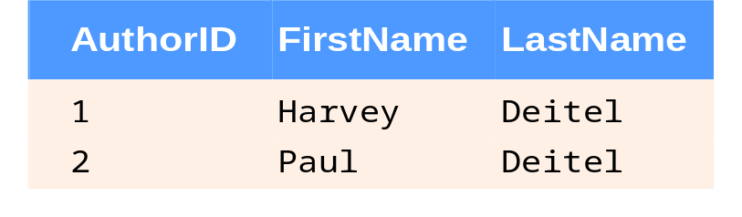
SQL (cont.)
Operator LIKE
Operator LIKE is used for pattern matching with wildcard characters percent (%) and underscore (_)
A pattern that contains a percent character (%) searches for strings that have zero or more characters at the percent character’s position
SELECT AuthorID, FirstName, LastName
FROM Authors
WHERE LastName LIKE 'D%'

Slide 46
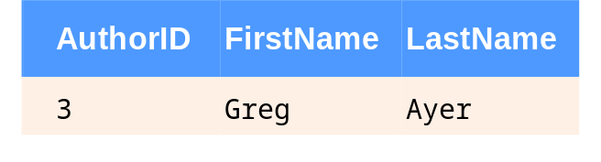
SQL (cont.)
Operator LIKE
An underscore (_) in the pattern string indicates a single wildcard character
SELECT AuthorID, FirstName, LastName
FROM Authors
WHERE LastName LIKE '_y%'

Slide 47
Visual Basic Classes
Three main classes will be used to establish a connection and to manipulate data from a database
  OleDbConnection Class
    Represents an open connection to a data source
  OleDbDataAdapter Class
    Represents a set of data commands and a database connection that are used to fill the DataSet and update the data source
  DataSet Class
    Represents an in-memory cache of data

